Slide 1
Chapter 2 Review

Slide 2
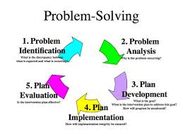
How do you begin the problem-solving process?

Slide 3
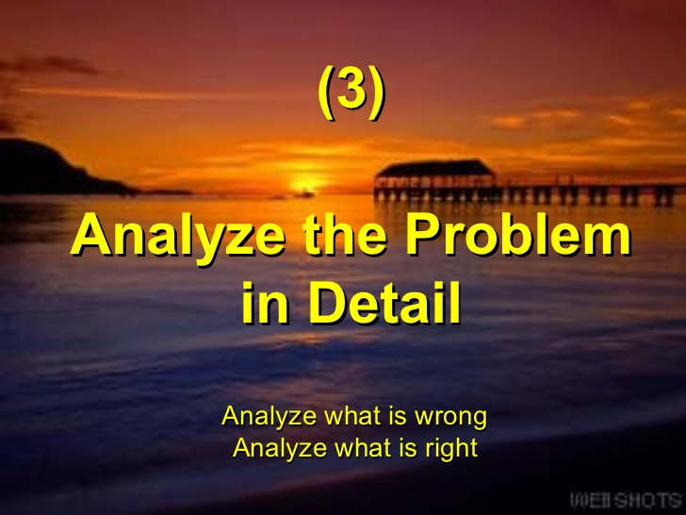
Answer: How do you begin the problem-solving process?

Slide 4

How do you end the problem solving process?

Slide 5
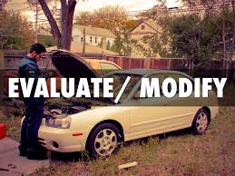
Answer: How do you end the problem solving process?

Slide 6

What is the step of the process that you complete twice?

Slide 7
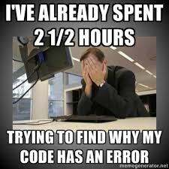
Answer: What is the step of the process that you complete twice?
Desk-check the algorithm

Slide 8

Why is output usually identified first?

Slide 9

Answer: Why is output usually identified first?
Because it is the goal of the program.

Slide 10
Output
Is Displayed, Printed or Stored in a file

Slide 11

What is input?

Slide 12
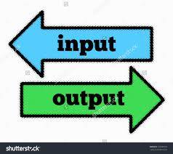
Answer: What is input?
The information will the computer need from the user to create the output.

Slide 13
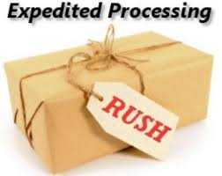
What is a processing item?

Slide 14
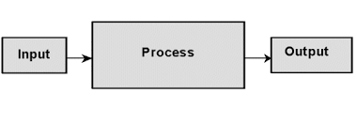
Answer: What is a processing item?
A variable that is not entered by the user or displayed to the user. It is only used in the program for calculations or processing of data.

Slide 15
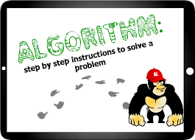
Algorithms

Slide 16
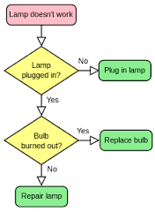
Flowcharts

